Slide 1
Unveiling Sasquatch:
A statistical journey into Bigfoot Sightings
Jacob Woolley, Kat Chu, Oumar Diakite,
Quinn Daley, Mackenzie Deetz

Slide 2
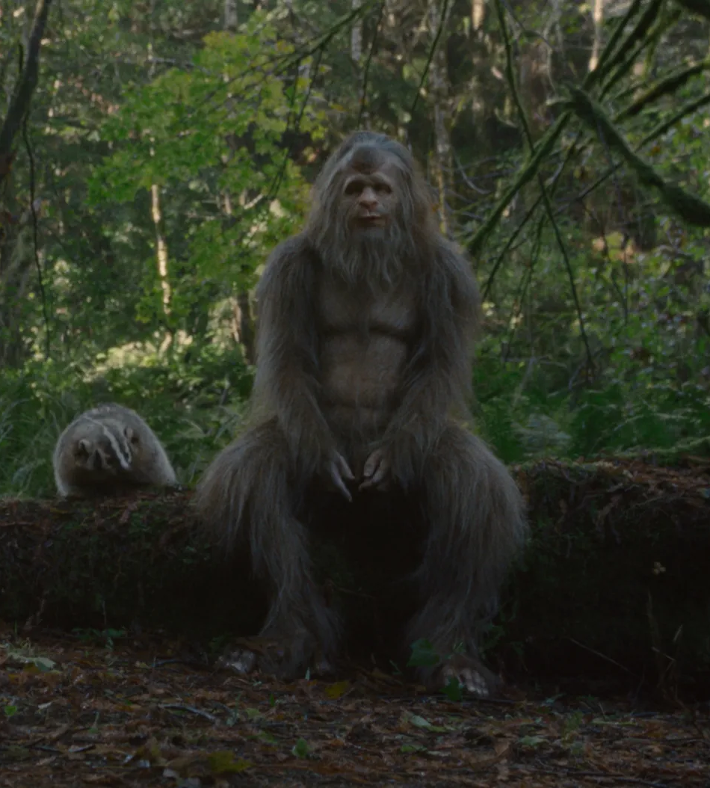
Who is Bigfoot?
A large, hairy, man-like creature ranging from 6 to 15 foot tall often reported to have a foul smell, who will admit a high pitched cry. They are reported to have footprints that are 2 feet long and 8 inches wide.
Most scientists deny the existence of Bigfoot saying that people are seeing other animals, mostly bears that resemble the creature.
Despite this, many have claimed to see and hear Bigfoot, often while in wooded areas hiking or hunting
Notes:
Information found at
Sasquatch | Bigfoot, Description, Sightings, & Facts | Britannica
Speaker Notes: Welcome, everyone, to our exploration of one of the most enduring mysteries in modern folklore—Bigfoot.
We’re talking about a large, hairy, man-like figure, reported to range anywhere from 6 to 15 feet tall. Witnesses often describe a foul smell accompanying the creature, along with a high-pitched cry.. Bigfoot is also said to leave behind enormous footprints—2 feet long and 8 inches wide, raising questions about what could make such impressions.
Despite these reports, most scientists dismiss Bigfoot as a myth, attributing sightings to misidentified animals, particularly bears. However, the legend persists, with many people still claiming to see and hear Bigfoot, especially in remote, wooded areas during hikes or hunts.
Today, we’ll dive into these sightings and examine the evidence, exploring why Bigfoot continues to capture the public’s imagination despite the scientific skepticism.

Slide 3
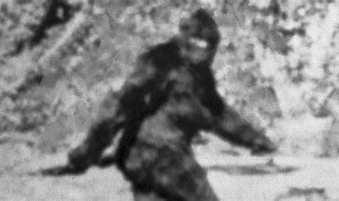
Image from Roger Patterson’s Recording in 1967

Slide 4
Preface
What questions did we want to answer
Why we chose this data
What are the factors that drive bigfoot sightings?
Large database of independently reported sightings, including time, location, and weather.
Where this data is from? Clean? Trustworthy?
BFRO.net, compiled by Timothy Renner. Some entries are incomplete. Entries can be submitted by anyone.
Notes:
So, let’s talk about how we got here. Bigfoot is one of those topics that’s just fun to dig into—it’s mysterious, a bit out there, and really captures people’s imaginations. When we started this project, we wanted to figure out if there were any patterns behind Bigfoot sightings. Like, are there certain places where people see Bigfoot more often? Does the time of year or even the weather have something to do with it?
To answer these questions, we pulled data from data.world which sourced their data from BFRO.net,which is the bigfoot field researchers organization website. It’s one of the largest collections of reported sightings, with details like time, location, and even the weather conditions when people claimed to see Bigfoot. So with all that in mind, my teammate Oumar is going to give more detail into how these sightings are classified

Slide 5
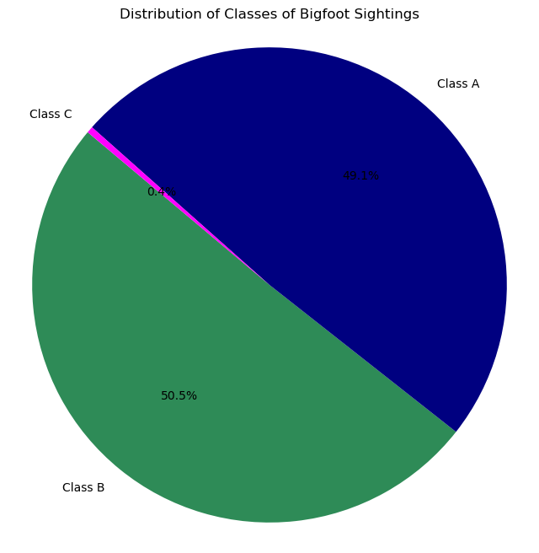
Classification Definitions
Class A
Direct Sightings
Class B
Indirect Sighting (hearing the high pitched scream, finding footprints)
Class C
Second hand stories

Slide 6
Table of Contents
1
2
3
4
5
Bigfoot Sightings by Year
BigFoot Sighting in the US and Canada
How many worldwide bigfoot sightings have there been since 1920?
Geographic Distribution and Classification
Distribution of Sightings by US regions
Bigfoot Sightings by Weather
Distributions of Sightings based on season and time of year
Trends of weather condition and visibility by classification.

Slide 7
01
Bigfoot Sightings by Year
How many worldwide bigfoot sightings have there been since 1920?
Notes:
When first evaluating our data set, an instinctual first move was to get get a more general sense of the data we were looking at and to try to just quantify the number of times Bigfoot has been seen over the past several decades. This would help in evaluate the overall scale of the number of sightings and identify if there were any more trends to explore in terms of Bigfoot’s popularity we could take a look at and see if they correspond to different cultural events.

Slide 8
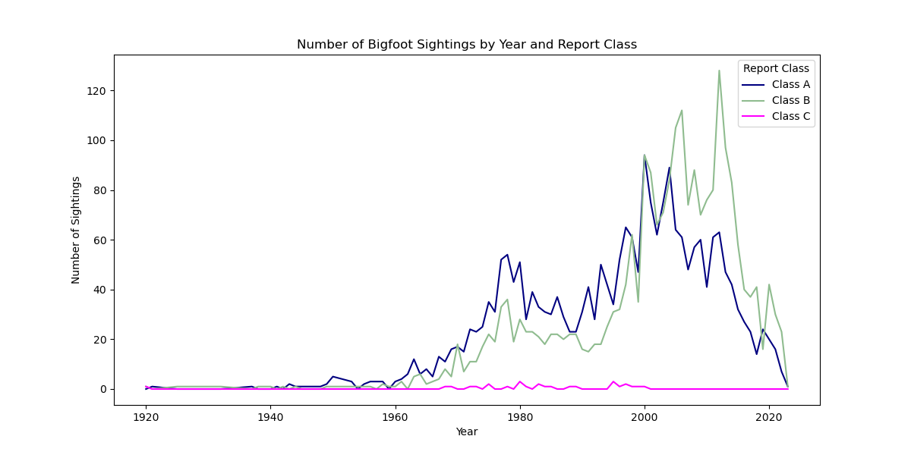
Notes:
To begin with, I really wanted to use as much of the slide as possible to show you as much of this graph as possible.
This graph shows the number of Bigfoot sightings (y axis) over time (x axis), categorized by report class (legend):
Class A (Direct sightings)
Class B (Indirect sightings like hearing sounds or finding footprints)
Class C (Second-hand stories)
To create this graph, the code first read in the data from a JSON file using Pandas and was the data was cleaned. Once the data was prepped, it was grouped by 'YEAR' and 'REPORT_CLASS' to count the occurrences and then pivoted for plotting. Finally, the number of sightings by year and report class was plotted using Matplotlib and saved as a PNG file.
Now, focusing on the trends:
Notice the significant increase in sightings, particularly from the 1970s onward, possibly reflecting growing public interest or increased media coverage.
Class A sightings are grow rarer by year following the early 2000;s, suggesting that direct encounters may have been less frequent, which maybe could indicate as technology got better, it became harder to “prove” a direct encounter
The decline in sightings across all classes from the early 2000s might suggest a waning public interest or increased skepticism about bigfoot’s existence
A spike in Class B sightings around the late 1990s and early 2000s could indicate a period of heightened indirect evidence or possibly correlate with popular media influencing public perceptions.
This figure provides valuable insights into how Bigfoot sightings have evolved, how they differ by type, and how external factors might influence reporting.

Slide 9
02
BigFoot Sighting in the US and Canada
Geographic Distribution and Classification

Slide 10
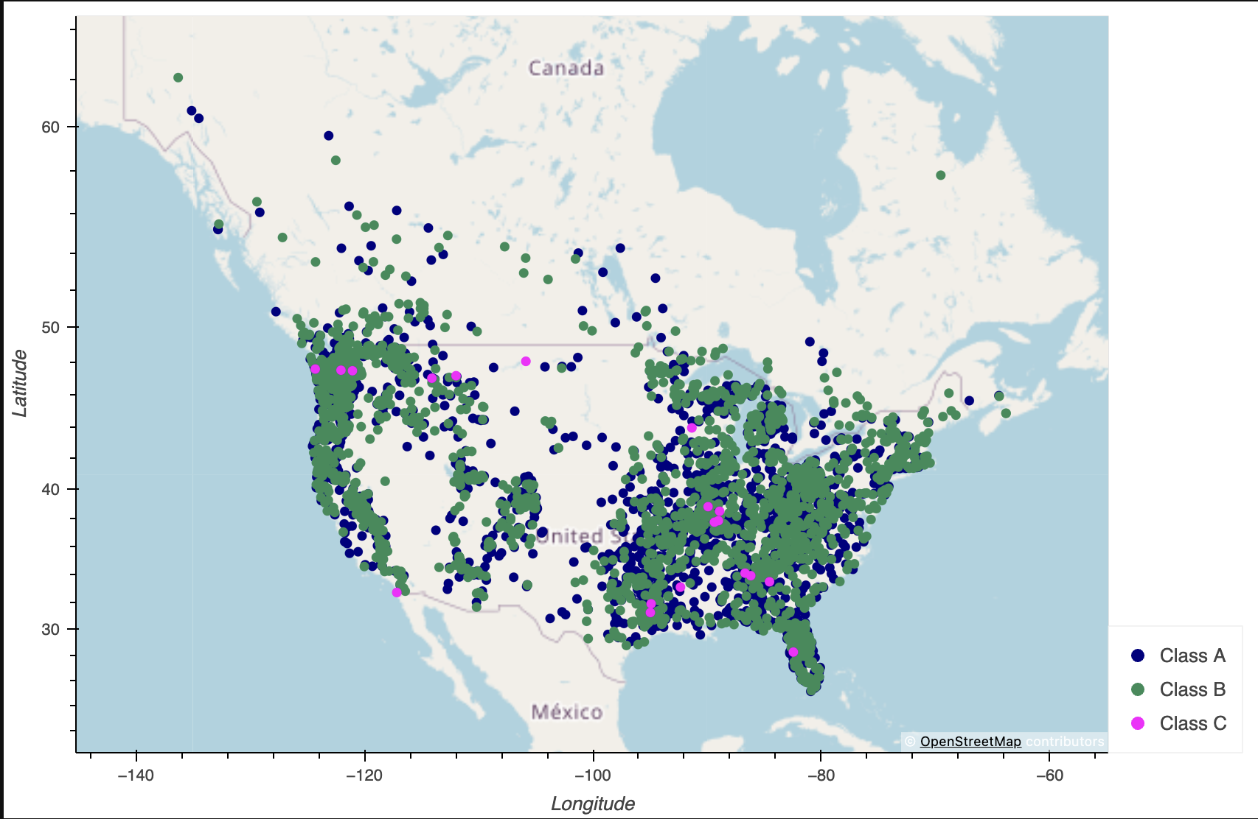
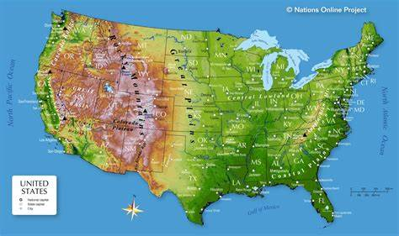
Distribution of the Sighting across North America
Class A (most credible)
Class B (less credible)
Class C (least credible)

Slide 11
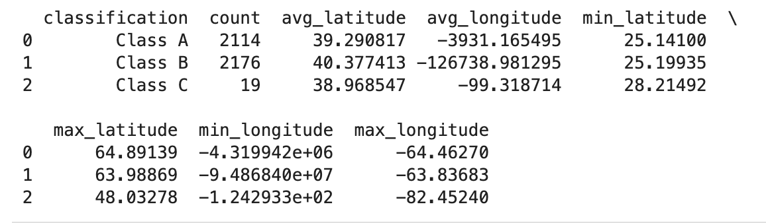
Statistical Summary

Slide 12
03
US Regions and their Sasquatch Sightings
Where in the US are bigfoot sightings happening?
Notes:
The US is divided into four regions, and we looked at how Sasquatch sightings differ across each one.

Slide 13
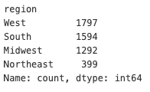
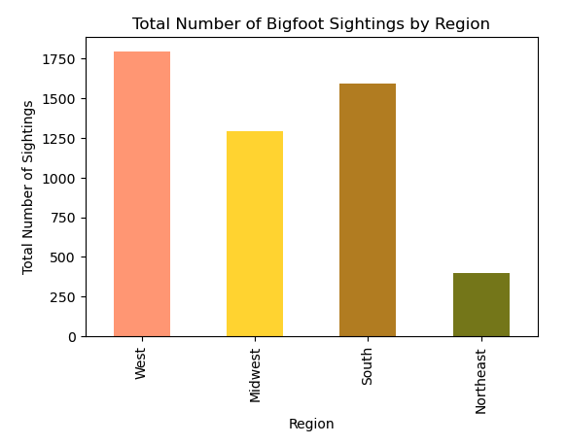
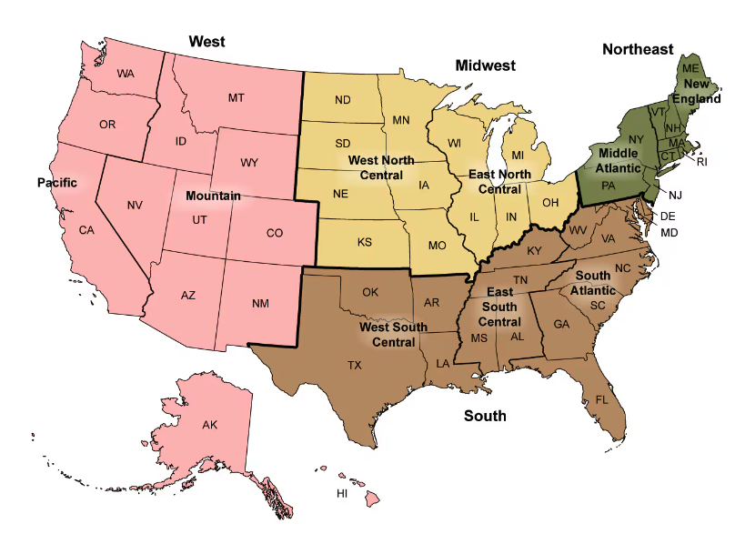
US Regions and Bigfoot Sightings
Notes:
I categorized states into regions (West, Midwest, South, Northeast) to analyze the distribution of Sasquatch sightings across these areas. These regions of the US defined by the CDC are shown on the map on the right. By aggregating the data, we counted the total number of sightings and classified them by region, which helps us understand how sightings are distributed. Then we visualized the total number of sightings in each region using a bar chart.
Some key findings were
•The data reveals that the West has the highest number of Bigfoot sightings, followed by the South and the Midwest. The Northeast has the fewest sightings.
•This distribution could be influenced by factors such as population density, forested areas, and cultural interest in Bigfoot lore.
•The significant difference between regions suggests that Bigfoot sightings are not uniformly distributed across the U.S.

Slide 14
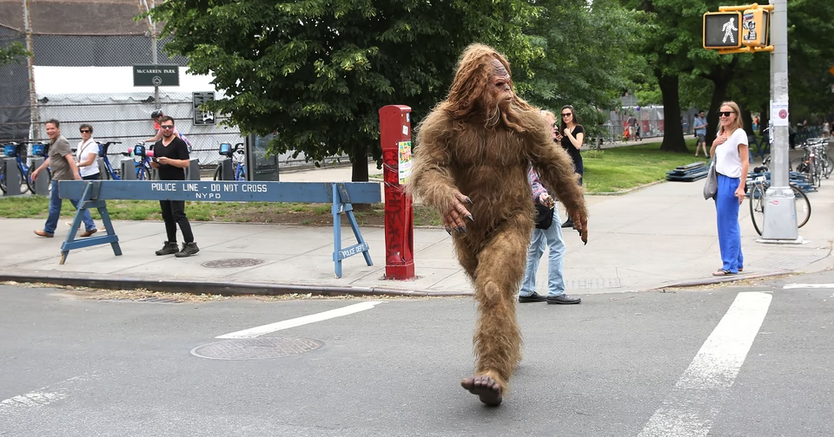
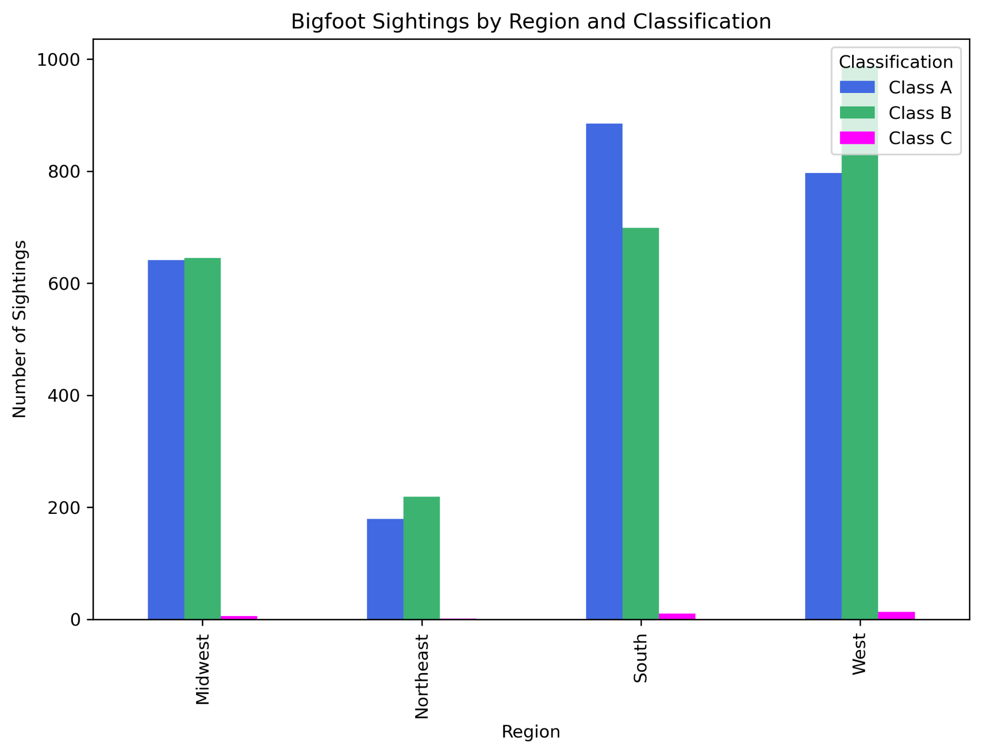
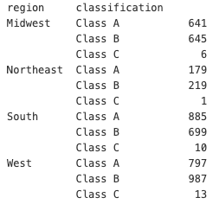
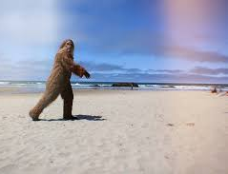
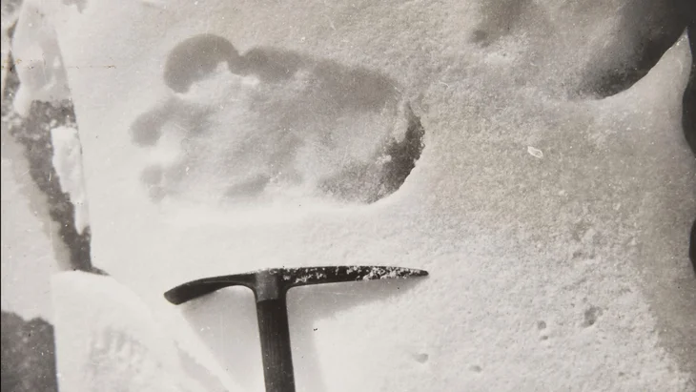
Region and Classification
Notes:
With that in mind, i wanted to see if Classification had anything to do with the why the West and South had the most sightings.
So with the US regions divided with their sighting classification we found a key few findings.
1. West and South Lead in Sightings: The West and South regions have the highest number of Bigfoot sightings overall. Both regions show a relatively balanced mix of Class A (more credible) and Class B (less credible) sightings.
2. Class C Sightings are Minimal: Across all regions, Class C sightings (least credible) are barely visible, indicating that these reports are much rarer compared to Class A and B sightings.
3. Midwest Shows Consistency in A and B: The Midwest has a nearly equal number of Class A and Class B sightings, each around 600 reports. This suggests that both types of reports are common in this region.
4. Northeast Has Fewer Sightings: The Northeast has significantly fewer sightings compared to the other regions, with Class B slightly outpacing Class A, though both are much lower than the counts in other regions.
As we’ve seen how different regions and various factors contribute to Bigfoot sightings, let’s now turn our attention to how seasonal changes and specific months may influence the frequency of these sightings.

Slide 15
04
Months and Seasons
How does the time of the year effect sightings?

Slide 16
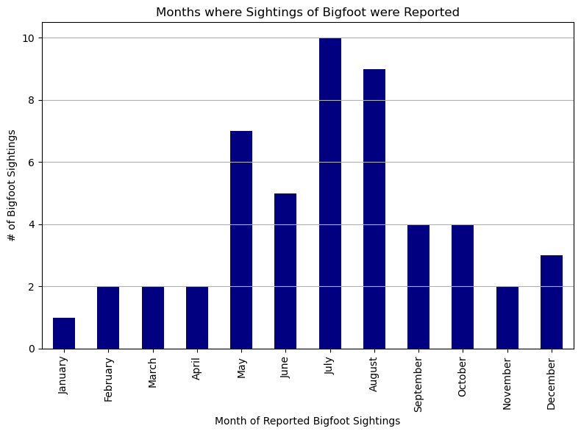
Most popular Months for Reported Sightings
Most sightings happen in May, June, July, and August
There are also an increase in sightings September, October, and December
The least sightings happen in January, February, March, and April
Why?
This during the summer when more people are outside, hiking, etc.
Notes:
Most popular months are May, July, and August(Spring, Summer)
Next Most Popular September, October, December
Least popular are January, February, March, April, and November( Winter, early spring)
This makes sense since more people are out in the summer months and visibility with would be easier in these months in most states

Slide 17
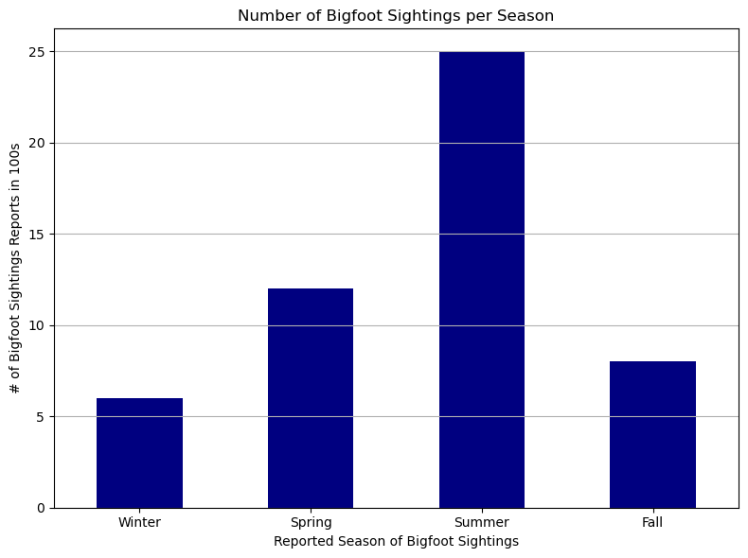
Most Popular Seasons of Bigfoot Reports
Most sightings happen in the spring and summer
The least sightings happen in the fall and winter
Why?
This during the summer when more people are outside, hiking, etc.
Winter people tend to spend more time inside and visibly may be compromised
Notes:
Supports the previous slides that summer is the most popular season where most Bigfoot sightings occur in

Slide 18
05
Weather and Conditions
How does weather and visibility effect sightings across classes?

Slide 19
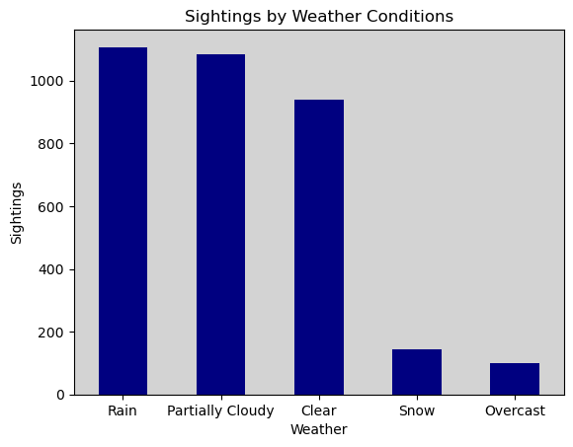
Weather
Wet conditions
Rain and clouds more common
Rare snow
Location vs outdoor activity
Few Overcast
Bigfoot prefers some sun

Slide 20
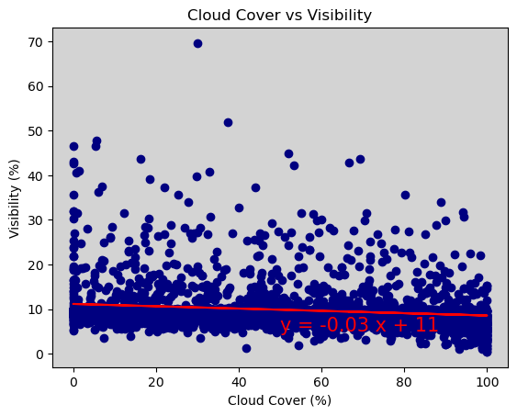
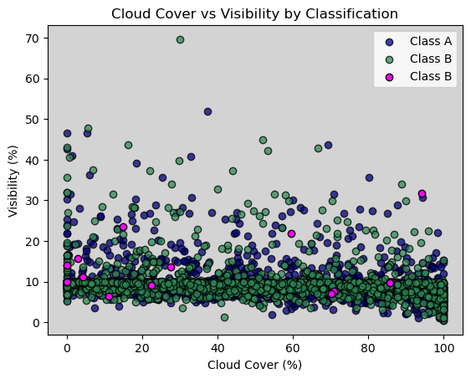
Visibility

Slide 21
Class A vs B T-Tests
Condition | p-Value
High Temperature | 0.9666
Low Temperature | 0.3239
Dew Point | 0.0612
Humidity | 0.0041
Cloud Cover | 0.0019
Moon Phase | 0.9111
Precipitation Intensity | 0.1126
Precipitation Probability | 0.8938
Visibility | 0.7100
Barometric Pressure | 0.0159
Mean: A(69.6%) vs B(68%)
Mean: A(47.5%) vs B(44%)
Mean: A(1017 mbar) vs B(1016 mbar)

Slide 22
The Conclusion
Questions Answered
Continued Analysis
What environmental or situational factors are associated with Bigfoot sightings? Are certain regions more prone to these reports?
Further analysis could include the demographics of people who claim to have seen bigfoot.
Summary
External Factors
Sightings increased after 1970 and peaked around 2000. From the 2000's onward, there has been noticeable decline in sightings
West and South Regions had the most sightings and credibility.
Summer months have more sightings.
Weather has no significant impact on sightings.
That could influence our data include culture and imagination. Are there certain regions that more so believe in this conspiracy theory?
Notes:
As we’ve seen throughout this presentation, several factors appear to be associated with Bigfoot sightings. We’ve explored how certain regions, particularly the West and South, have more frequent reports. We also considered how the time of year and no specific weather conditions might influence the likelihood of these mysterious encounters.
However, while we’ve identified patterns, it’s important to remember that correlation doesn’t mean causation. The factors we’ve examined suggest conditions that might make sightings more likely, but they don’t confirm the existence of Bigfoot. There could be external influences at play, such as regional culture, media coverage, or even biases in reporting.
In the end, our analysis has provided insights into when and where these reports are most common, but the mystery remains unsolved. Whether these patterns reflect environmental factors or simply human perception influenced by local myths and culture, there’s room for continued exploration and deeper analysis

